Slide 1
AN ONLINE ASSIGNMENT AND FEEDBACK SYSTEM
System Analysis And Design Document.

Slide 2
Members
OTIENO HENRY OOKO CS282-1603/2014
KARANJA DAVID KAMANDA SCT212-6247/2015
KELVIN NGARE CS282-5164/2014

Slide 3
Introduction
The purpose of this document is to present the detailed description (functional and non-functional user or system requirements) of the online assignment submission and feedback system.
It will explain the purpose and features of the system, the interfaces of the software, what the system will do and the constraints under which it must operate.

Slide 4
SYSTEM ANALYSIS
System analysis is a process of collecting and interpreting facts, identifying the problems, and decomposition of a system into its components.
System analysis is conducted for the purpose of studying a system or its parts in order to identify its objectives.
It is a problem-solving technique that improves the system and ensures that all the components of the system work efficiently to accomplish their purpose. In other terms it specifies what the system should do.

Slide 5
Users
Students.
Lecturers.
Administration.
User Requirement Definitions
A user requirement is the capability needed in a system by the user to solve a problem or to achieve an objective
The system should have records of students and faculty that can be accessed only by the authorized person.
The system should be more secure in managing user records and more reliable to work in any conditions.
Time can be saved by scheduling the assignments.

Slide 6
Functional requirements
Functional requirements are those requirements which deal with what the system should do or provide for users:
The system should allow students, lecturers and the administrators to view the results.
The system/Lecturer should be able to reject outdated assignments if the students submit after the deadline.
The system should allow downloading and uploading of assignments.
The system should be able to provide archive of past assignment information.
The system should allow users to log in and log out.

Slide 7
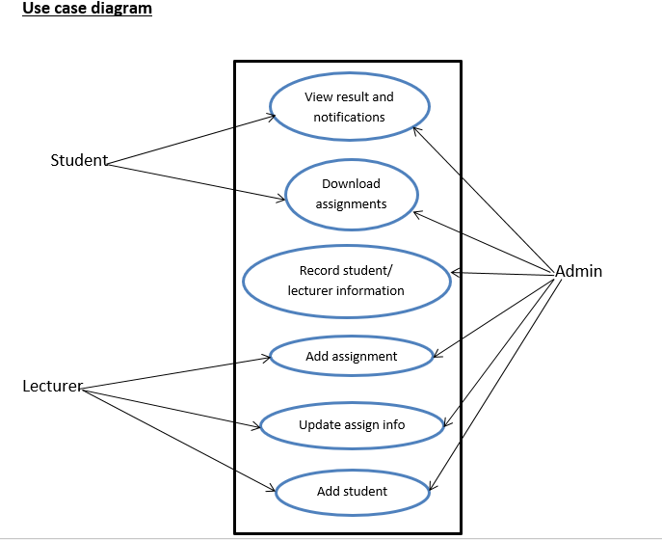

Slide 8
Non Functional requirements
Performance – the system is expected to have short time response.
Accessibility – the users will be able to access the system from anywhere anytime.
Reliability – the system will operate at all times to ensure that information is delivered on time.
Usability – the system will have good user interface that make the system usable to system users.
Security – passwords will be stored in the database in an encrypted form.

Slide 9
System Modules
There are three modules for our system:
Student module
Lecturer module
Administrator module
Student module:
The student will logon to the system and take his/her assignment. He/she can also check his previous examinations marks and his/her details. The students can also see notifications regarding pending assignments and reminders for due dates.
The features available to the Students are:
Can view the different categories of assignments which re available.
Can change their password.
Can view their marks.
Can view the various reading material if any.
Can view and modify their profile but to some limited range.

Slide 10
Lecturer module:
The database is prepared & loaded into the software. Selection for examination can be done language wise by the examiner. The results will be displayed immediately after completion of the examination.
The features available to the lecturer are:
Can view the different categories of assignments conducted by students.
Can change their password.
Can view marks for the students.
Can view and modify Results of the students.

Slide 11
Administrator module:
The administrator collects all the results after successful completion of the examination/assignments and can be used for analysis and also to monitor the performances of the students.
The features that are available to the Administrator are:
The administrator has the full rights over the system.
Can create or delete an account.
Can view all the accounts.
Can change the password for any account.
Can hide any kind of features from both users.
Insert, delete or edit the information of available on system.
Can access all the accounts of the faculty members and students.

Slide 12
System Specification
Operating Environment
Hardware and software requirements for our system are:
Minimum requirements:
Client Side:
Web Browser.
RAM 256MB
Free Disk Space 100MB
Server Side:
Computer
XAMPP Software

Slide 13
SYSTEM DESIGN
Introduction
System design is the process of planning a new business system or replacing an existing system by defining its architecture, components, interfaces, and data to satisfy the specific requirements. System Design focuses on how to accomplish the objectives of the system.
Architectural Design
Software architecture design is a document that contains various components of a system, with visible properties of those components and relationship among them.
It is a representation that allows software engineers to :
Analyze the effectiveness of the design in meeting its stated requirements.
Consider architectural alternatives.
Reduce the risk associated with the construction of the software

Slide 14
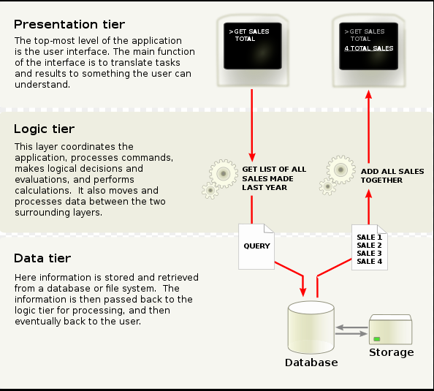
Architectural Design: Three-tier architecture:

Slide 15
Physical Design
This will describe how data is put into the system.
It includes:
interface design.
process design.
data design.

Slide 16
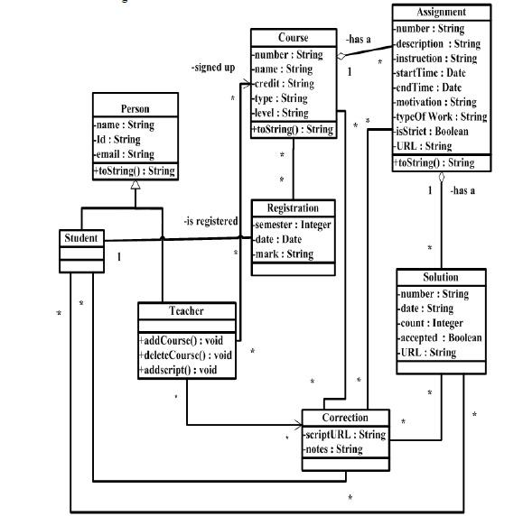
Class diagram

Slide 17

User Interface
Log In Form : Below is a login form where must login in order to interact with the system.
User I required to enter his/her username and password in order to get access to
the system.

Slide 18
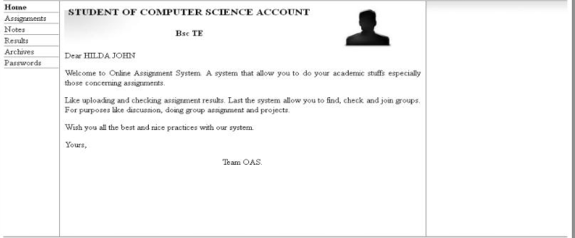
Student Home Page :

Slide 19
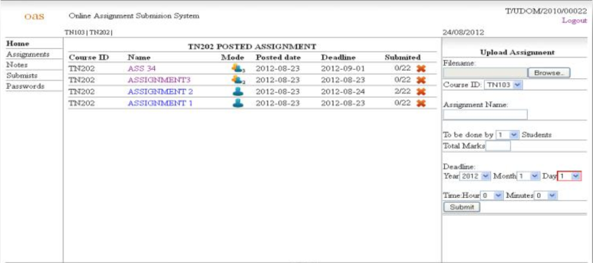
View Assignment: The Assignment module will display all assignments posted by the respective lecturers with added information:

Slide 20
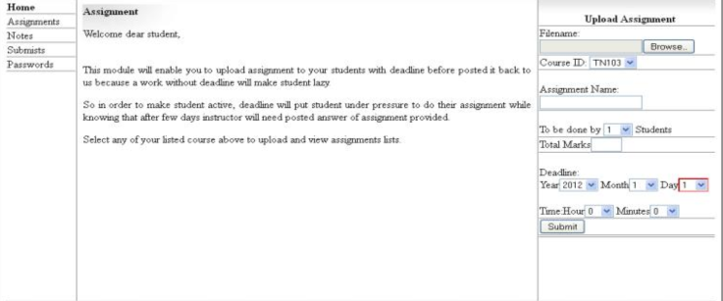
Student Submission Module: This module will allow the student to submit his/her assignment.

Slide 21
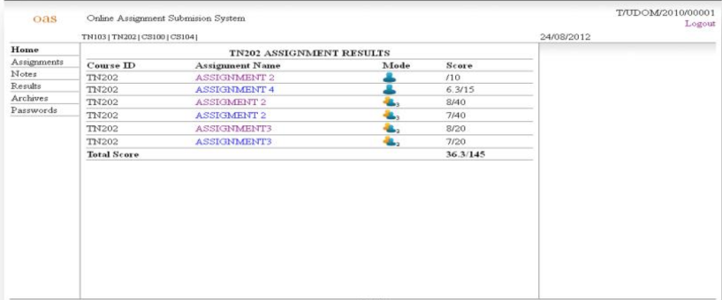
View Result: After the respective lecturers have mark their students assignments, the respective marks will be displayed here.

Slide 22
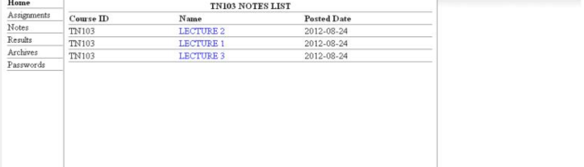
NOTES: This module will enable Lecturers to send Unit notes to their students and allow them to download the notes.

Slide 23
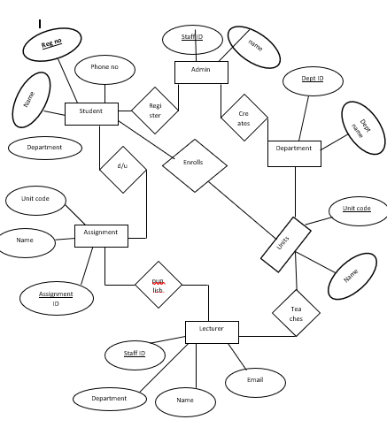
ER diagram

